Slide 1
String ,StringBuffer and StringBuilder

Slide 2
String Class
Strings in java are immutable means once created they cannot be altered
If we alter that will lead to creation of new string object
All the string objects are stored in String pool in heap memory
String pool is pool of strings stored on Java heap memory
Strings are thread safe because they are immutable means two threads can not access the same string at a time

Slide 3
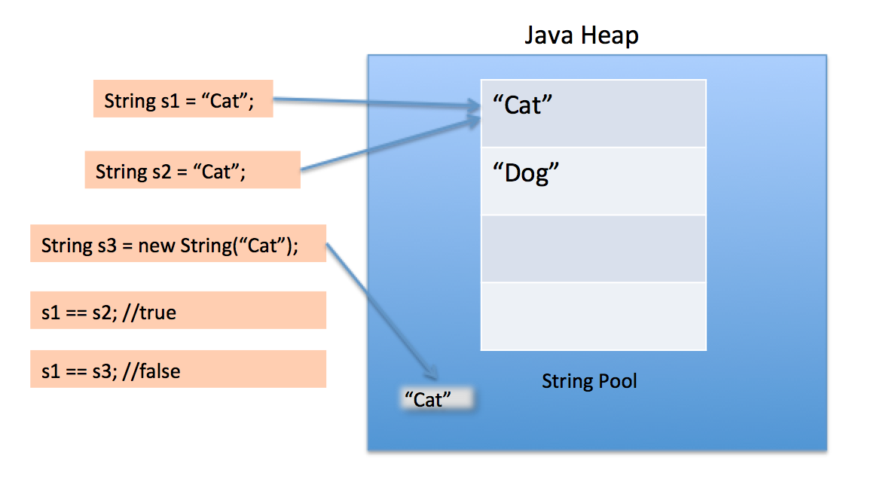
String Class
String pool is a group of strings stored on java heap memory
Notes:
Image src : http://www.journaldev.com/797/what-is-java-string-pool

Slide 4
String Class example
String s1 = “Cat”
String s2 = “Cat”
String s3 = new String(“Hello”)
The difference between above three statements is that, s1 and s2 are pointing to the same memory location i.e. the string pool. (Refer to the Diagram in previous slide)
s3 is pointing to a memory location on the heap. Because using a new operator creates a memory location on the heap.
S1 = s1+ “is rat” → Creates a new string in the String pool
Any alterations by adding characters/Strings to the existing string will leads to new string on heap and even concatenation of two strings leads to new string this is why String class is immutable in Java

Slide 5
StringBuffer Class
What if we need to modify our string variable without creating a new string on java heap
StringBuffer is similar to String class but it is mutable, means we can alter the string once we created without creating a new String
StringBuffer s1 = new StringBuffer("Hello");
StringBuffer has many utility methods that can be used to manipulate the string.
append()
delete()
insert()

Slide 6
StringBuffer Class
In additon to above methods StringBuffer is synchronized and thread safe.
StringBuffer is more useful in multi threading environment
Two threads can not access the same method on StringBuffer object so it thread safe
StringBuffer is slow compared to StringBuffer because of high overhead
public class myStringBuffer{
public static void main(String args[]){
StringBuffer s1= new StringBuffer(“Hello Java”);
s1.append(“Bye”);
System.out.println(s1);
}
}
above code appends the string Bye to Hello Java and prints it to the screen.

Slide 7
StringBuilder Class
StringBuilder is same as StringBuffer except it is not Synchronized.
Two threads can access the same method on StringBuilder object so it is not thread safe
StringBuilder is fast compared to StringBuffer
public class myStringBuilder{
public static void main(String args[]){
StringBuilder s1= new StringBuilder(“Hello Java”);
s1.append(“Bye”);
System.out.println(s1);
}
}
above code appends the string Bye to Hello Java and prints it to the screen.

Slide 8
Stack and Heap Memory
The End

